Slide 1
NVHousingSearch.org

Slide 2
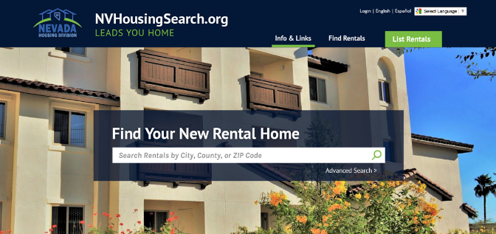
Overview of NVHousingSearch.org
Statewide service helping landlords and tenants find each other
Free to search and list all types of rental housing: market properties, tax credit housing, single family, multi-family, mobile homes, rooms for rent
Available online 24-7 and also supported by a toll-free, bilingual call center, M-F, 6 a.m. to 5 p.m. PDT to reach live assistance 1-877-428-8844
Service is ADA Title II 508 compliant; works with assistive technology
Listings available by phone, fax, email and letter
Detailed property listings include pictures, maps
Easy email reminders help landlords keep information fresh
Established disaster housing resource

Slide 3
Example of search results

Slide 4
Locator background
In 2009 Nevada Housing Division was mandated by the legislature to create and maintain a state-wide low income housing database (NRS 319.143).
NVHousingSearch.org is a part of the effort to meet this mandate.
Service launched in September of 2014
Over 45,000 units are represented in the listings as of June 2019 and the website hosted over 74,000 searches last year
As of 2015 new tax credit properties were required to list in NVHousingSearch.org
In June 2019 SB 104 passed and moved responsibility for the “locator statute” from Aging and Disability Services to the Housing Division.

Slide 5
NRS 319.267 now a part of NRS 319.143
If an owner of multifamily residential housing that is offered for rent or lease in this State and is:
(a) Accessible to persons with disabilities; and
(b) Affordable housing, as defined in NRS 278.0105,  has received any loan, grant or contribution for the multifamily residential housing from the Federal Government or the State, the owner shall, not less than quarterly, report to the Division information concerning each unit of the multifamily residential housing that is available and suitable for use by a person with a disability.

Slide 6
Some new features
Responsive design for laptops, tablets and phones
Automatic uploading of rent and vacancy information for Entrada property management software
New easier to fill out data entry form for landlords
New email reminders for easier updating
Map-list toggle, standard-detailed toggle
Blog includes stories about new and rehabbed affordable properties
Will have new search bar

Slide 7
One-stop shop for Nevada affordable housing
261 of 267 tax credit properties listed (not including TC properties under construction)
60 of 62 private properties with HUD project based rental assistance listed
64 of 64 private properties with USDA RD properties listed
22 of 37 public housing properties (not including single family with PBV)
25 of 42 other affordable subsidized properties
Bottom line: 356 of 396 of Nevada’s subsidized multi-family housing listed
32,000 units of mixed income or affordable housing
Over 13,000 private market units including single family, mobile homes and apartments

Slide 8
Accessibility features sample
Available Nevada housing units with accessibility characteristics June 4, 2019
Notes:
Landlords may enter data on up to 32 different accessibility features. The graph of available units by accessibility feature contains 13 of these. Landlords are not required to enter this information although we have encouraged them to enter as much as possible. The variations in number of available units for various features above may reflect many factors: how rare a feature is, whether landlords are aware of the features and whether they chose to enter the information about them and how much demand there is for particular types of features. In addition to these accessibility features information about distance to bus stop, playground, grocery shopping, hospital and pharmacy may be entered.

Slide 9
Toll-Free Call Center
Connecting tenants with housing
Helping landlords add and update listings
No limits on call times: callers receive as much assistance as they need
Monday - Friday, 6 a.m. - 5 p.m. Pacific
1-877-428-8844
Notes:
Socialserve call center is a non-profit entity which serves tenants and landlords from over 30 states and localities. The call center staff are trained to handle calls regarding housing. Some of the staff have themselves experienced housing crises. They have no time limit so that they are able to give callers as much assistance as they need.

Slide 10
We can use your help:
Get the word out to groups and individuals
We can provide materials to hand out and short customized trainings
Link to our site
Let us know about events
Help us recruit more listings
Reach out to your favorite landlord
Give us your feedback about how it is working
THANK YOU!

Slide 11
Contact Information: 1.877.428.8844 for more information and free trainings for staff
Elizabeth Fadali
efadali@housing.nv.gov
775-687-2238
Sheila Roberts
sroberts@emphasys-software.com
770-800-1057
NVHousingSearch.org

