Slide 1
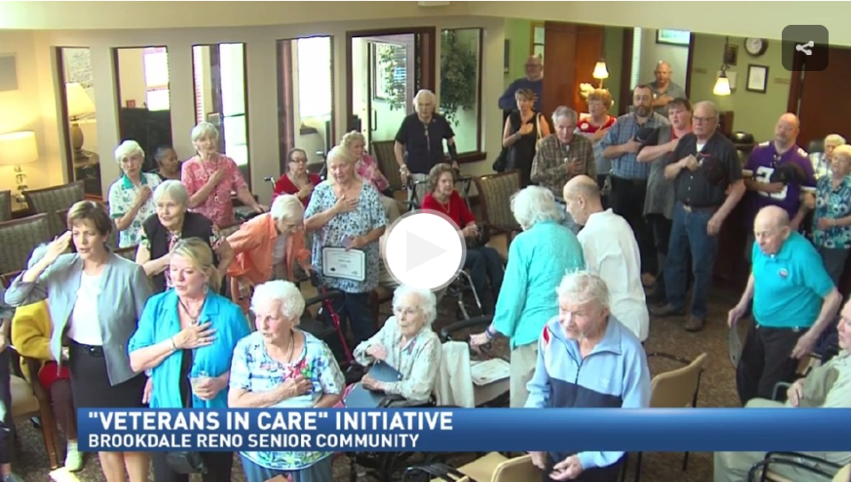
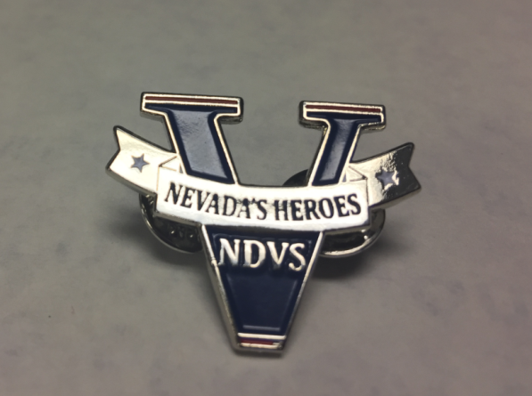
Nevada Veterans in Care Program “VIC”

Slide 2
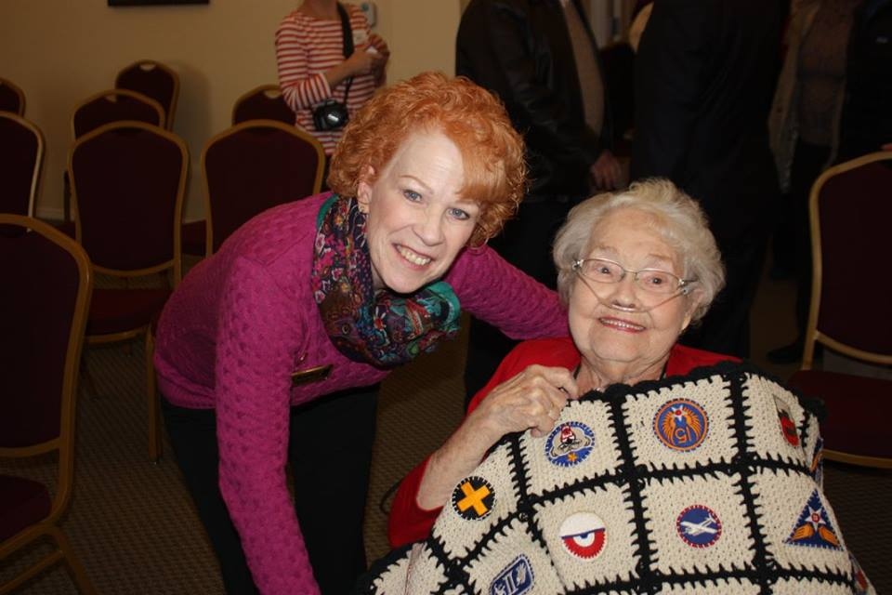
Problem
Less than 20% of Nevada’s aging veterans file for earned benefits
Many Nevada veterans in care facilities are spending down their savings (not accessing VA benefits) leaving Federal benefits unclaimed
When moving to a non-veteran community care setting, a veteran’s personal history, including military service, is often forgotten
In non-veteran home care facilities, staff don’t always understand military culture and its impact on behaviors
Our older veterans are passing away and we have only a short time to give a final thank you
Notes:
America’s newest veterans are filing for disability benefits at a historic rate; 45 percent of the 1.6 million veterans from the wars in Iraq and Afghanistan are seeking compensation. But in Nevada, almost every day we find a senior veteran who is eligible for compensation, pension, or aid and attendance—and was either not aware of the fact or was unable to connect to these benefits for a variety of reasons.
Aging veterans are often unable to attend veteran-related events due to health, mobility or transportation issues or may be unable to access or understand benefit information without assistance due to cognition changes or difficulty with visual acuity and hearing.
In the meantime, some of these hidden heroes are quickly spending down their savings to pay for their care. Community care facilities and health care costs can be very expensive. At this time, Nevada has a single veterans nursing home, located in Southern Nevada near Las Vegas. The facility maintains a waiting list for admission. Without private insurance, many veterans cannot afford the cost of long term care and may be living in undesirable environments when may qualify for financial assistance through aide and attendance.
The population of WWII veterans and Korean War veterans is rapidly diminishing. Every day … every contact … counts. Through the VIC program, NDVS has an opportunity to contact the veteran where they live, help connect them to benefit representatives and honor them for their service.

Slide 3
Veterans In Care Program Purpose
Improve quality of care for veterans in care facilities throughout the state—not just in the ones the state manages
Help veterans in care and homebound vets tap into earned benefits
Brings together communities to celebrate the service of veterans and spouses in care facilities
Provides military culture education to enhance understanding of how the military experience affects the aging veteran
Notes:
The Nevada Veterans Advocate Program (NVAP) trains participants to help veterans and their families connect to benefits and opportunities that improve their lives. The program is creating a State-wide network of knowledgeable advocates, ensuring that wherever a veteran lives, there is someone who can help them access needed benefits. The program:
Capitalizes on the selfless service of volunteers who want to help veterans
Ensures that participants who advise veterans have current and relevant information
Partners advocates with VA Accredited VSO’s for mentorship and continuing education
Places trained benefit “connectors” in rural communities who can help veterans that experience challenges accessing information

Slide 4
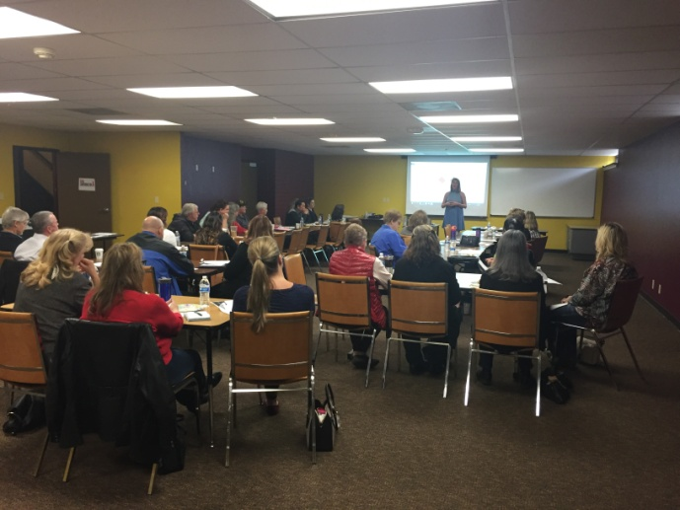
Improve Quality of Care
Continuing Education Unit (CEU) workshops for providers and community through training called “Bravo Zulu- Achieving Excellence in Relationship Centered Care”
These workshops were provided state-wide at no cost to attendees
Included a strong overlay of the military experience’s effect on the aging process as well as those with dementia and difficult behaviors
Participant quotes:
BG:“The information is useful as to how I approach and speak with the veteran about his/her service and how their behavior or reactions may be influenced due to their time in service.”
JL: “That we need to ask all residents if they served in the US Armed Forces, not just the men. Women who have served need the same respect and understanding if behaviors are present.”
Notes:
A series of 4, 4 hour workshops are offered in the north end and southern end of our state. Each “Bravo Zulu” (well done) offered in the series builds on the previous offering and has a learners guide shared with participants. The series keys in to 4 elements: 10 Valuing personhood and veterans; 2) Treating people as unique individuals; 3) Looking at the world from the perspective of the person; & 4) Providing positive and supportive social environment. This all spells “VIP’s”. The Sanford Center for Aging at the University of Nevada, Reno, and the Perry Foundation helped craft the program.
These workshops are easy to duplicate and will be repeated in our state to capture more providers and support systems. The development cost was $13,000 for the program and presenter.
We also had an additional offering from the Nevada Geriatric Education Center with a clinical behavioral management overlay. This workshop had 129 participants and was broadcast statewide with Zoom technology. The cost of this program was $10,000.

Slide 5
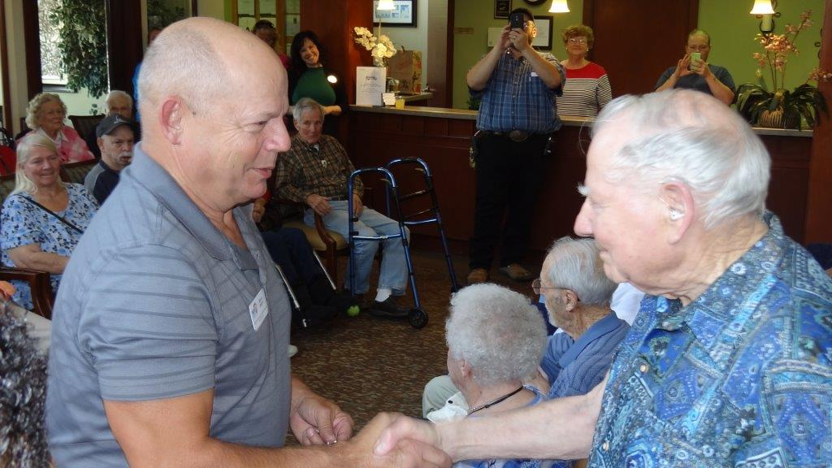
Connecting to Benefits
NDVS staff engages with facility administrator about services we offer; leaves brochures for staff, visitors and the veterans in residence
VSO’s address staff, veterans and family members and meet with veterans and families after the formal presentation, rescheduling follow-up visits
Data regarding the number of veterans served is being collected
Veteran quotes:
I didn’t realize that you could help me replace my lost ribbons and awards. I thought they were lost forever when I moved here.
I can’t believe you came to me! The last time I tried to get an appointment with the VA I was told I have to wait. At my age that is risky!
I hung my certificate up so now I can prove I was in the Army (lady vet).
Notes:
The VSO interaction has resulted in several instances of increased disability benefits for Vietnam vets with presumptive conditions.

Slide 6
Acknowledgement for Service
Started as a way to get a “foot in the door” and morphed to be as important as the other two goals
Currently have held 84 ceremonies honoring 1483 veterans, 45 veteran employees and all veterans spouse and family members in attendance. We schedule an average of 4-8 per month
Has resulted in over 1500 hours of community participation from veterans service organizations, color guards, student ROTC programs, women's veterans programs and our Nevada Veteran Advocate members

Slide 7
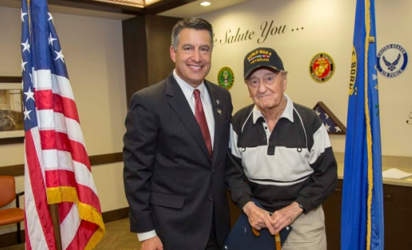
Facility Feedback

Slide 8
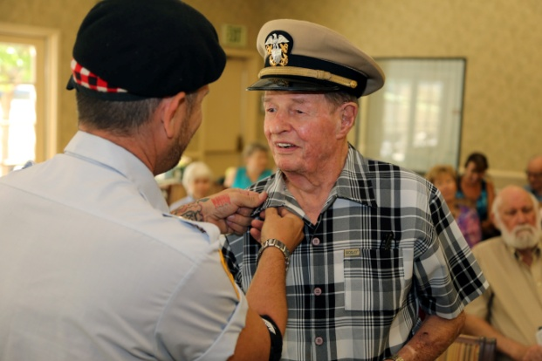
Challenges
Provider reluctance/perception of “need”
“How should I know who is a veteran?”
“I didn’t think it was a big deal”
Facility “poaching” fears
Facility concerns about confidentiality
VSO availability for post-event workload
Competition among community partners wishing to participate
Notes:
Nevada’s Governor Brian Sandoval honoring a WWII lady veteran who was 107 years old.

Slide 9
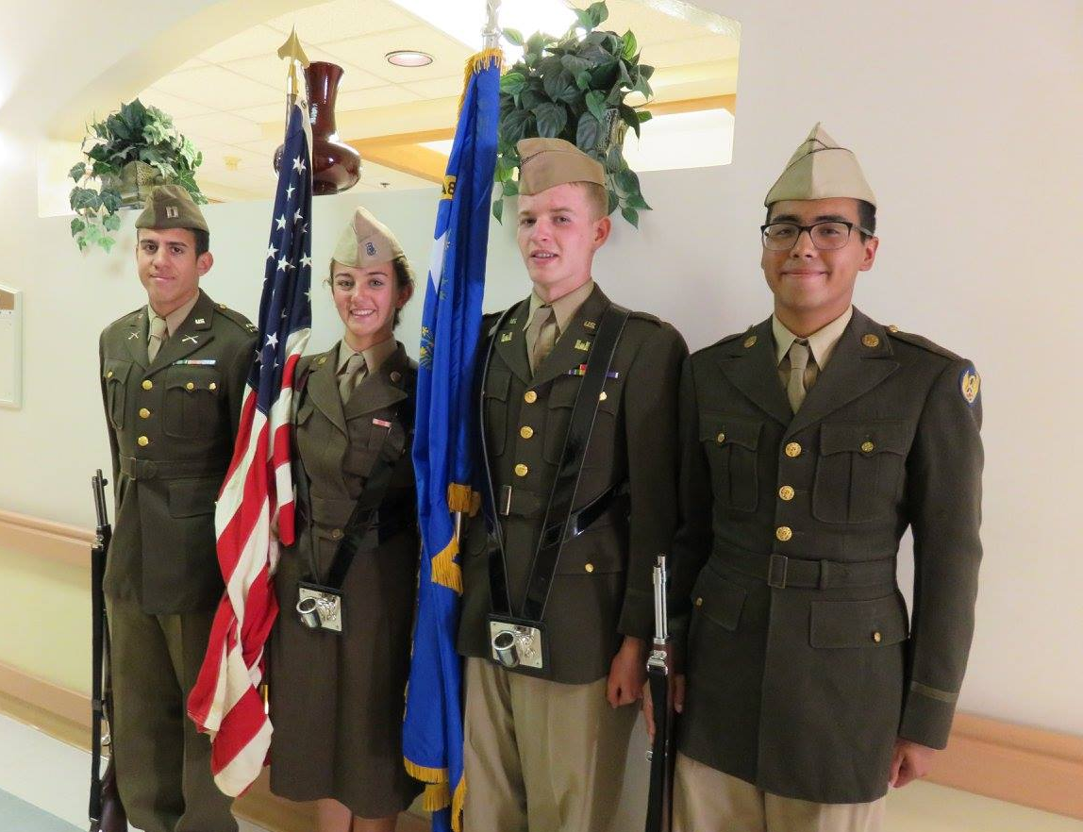
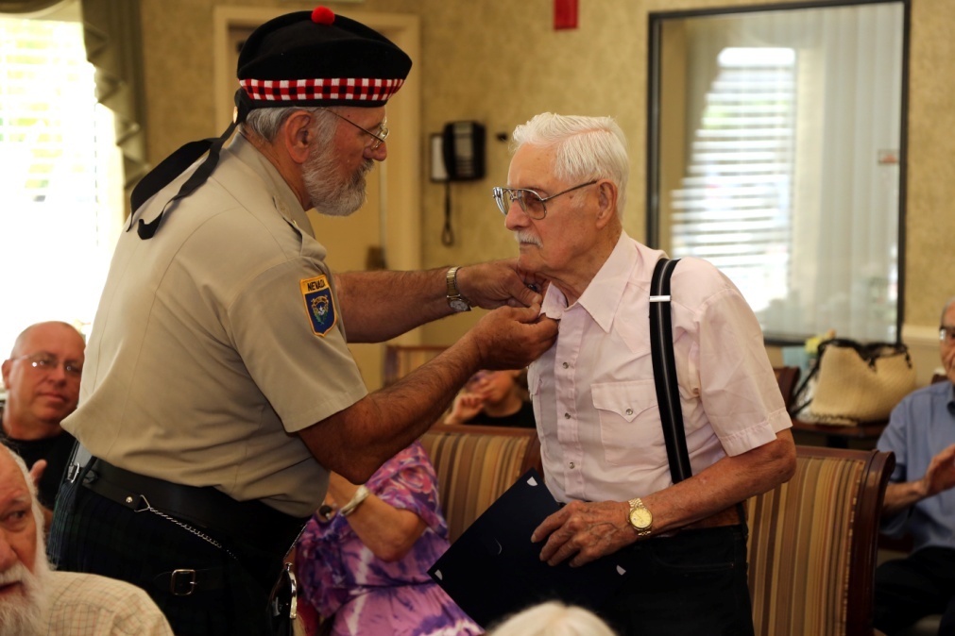
Building Partnerships
Schools & JROTC Groups
Veterans Organizations
Elected and appointed officials (Governor, Mayors, County Commissioners, etc), non-profit organizations, Rotary clubs, schools & JROTC groups, senior service centers, etc, etc, etc!

Slide 10
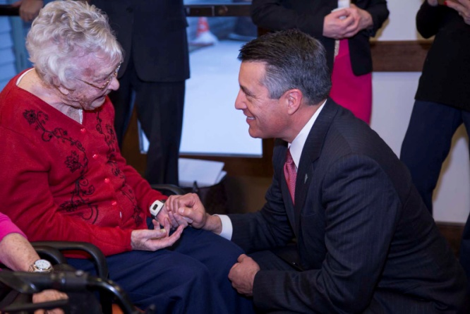
Contacts for Questions
Deputy Director of Wellness: Wendy Simons simonsw@veterans.nv.gov
Director Kat Miller: millerk@veterans.nv.gov www.veterans.nv.gov (775) 688-9757
Governor Brian Sandoval and Margaret, a 107 year old WWII veteran

